Slide 1
Presentation
Welcome to our presentation…

Slide 2
Group Members..!
Sabree Saberin Chowdhury (011181304)
Nusrat Jahan Nishe(011182074)
Miraz Kamal Hemal (011181068)

Slide 3
Presentation topic...
All pair shortest path - Floyd–Warshall algorithm

Slide 4
INTRODUCTION
the Floyd–Warshall algorithm is an algorithm for finding shortest paths in a directed weighted graph with positive or negative edge weights. A single execution of the algorithm will find the lengths of shortest paths between all pairs of vertices.

Slide 5
How this Algorithm works..?
Floyd-Warshall Algorithm is an algorithm for finding the shortest path between all the pairs of vertices in a weighted graph. This algorithm works for both the directed and undirected weighted graphs. But, it does not work for the graphs with negative cycles.

Slide 6
Time Complexity
Floyd Warshall Algorithm consists of three loops over all the nodes.
The inner most loop consists of only constant complexity operations.
Hence, the asymptotic complexity of Floyd Warshall algorithm is O(n3).
Here, n is the number of nodes in the given graph.

Slide 7
EXAMPLE
Floyd Warshall Algorithm is a famous algorithm. It is used to solve All Pairs Shortest Path Problem. It computes the shortest path between every pair of vertices of the given graph. Floyd Warshall Algorithm is an example of dynamic programming approach.

Slide 8
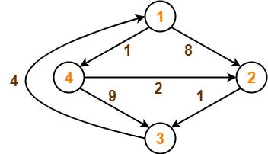

Slide 9
Remove all the self loops and parallel edges (keeping the lowest weight edge) from the graph.
In the given graph, there are neither self edges nor parallel edges.
Write the initial distance matrix.
It represents the distance between every pair of vertices in the form of given weights.
For diagonal elements (representing self-loops), distance value = 0.
For vertices having a direct edge between them, distance value = weight of that edge.
For vertices having no direct edge between them, distance value = ∞.

Slide 10
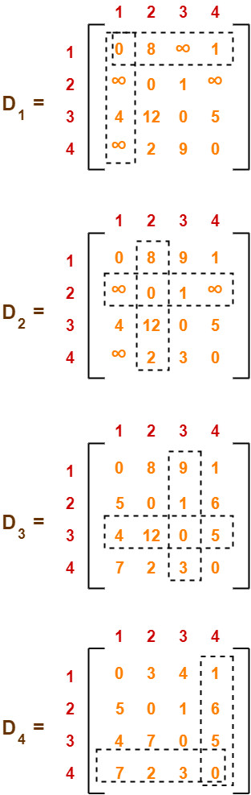
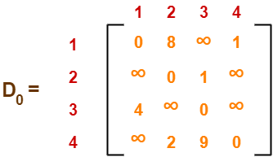

Slide 12
That's all .
Thank you ‼️

